Slide 1
Reference data and Accuracy Assessment

Slide 2
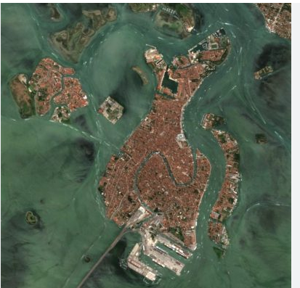
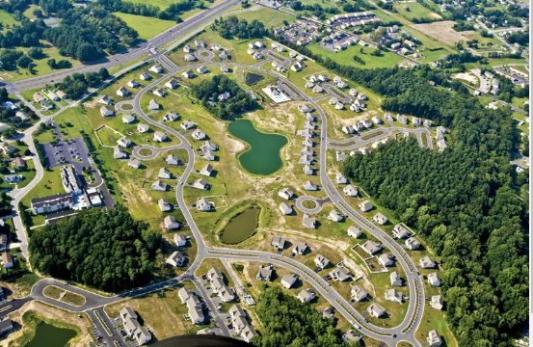
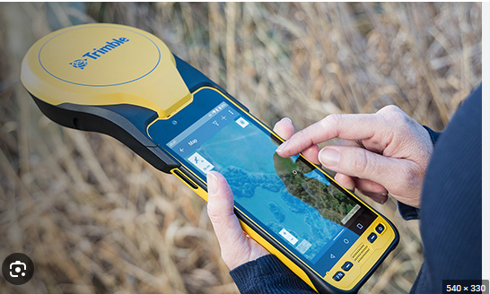
Sources of reference data
Aerial photo interpretation
Ground truth with GPS
High resolution satellite images

Slide 3
What to consider on collecting reference data
Choosing reference data
Make sure you can actually extract from the reference source the information that you need for the classification scheme
For example aerial photos may not be good reference data source if your classification scheme distinguishes four species of grass. Yo will need GPS ground data.

Slide 4
2. Determining size of reference plots
Match spatial scale of reference plots and remotely sensed data
GPS ground plots 5metres on a side may not be useful if remotely sensed cells are 1km on a side. You may need satellite images such as RapidEye that has 5m spatial resolution.

Slide 5
Accuracy Assessment
Assessing accuracy of a remote sensing output is one of the most important steps in the classification process.
It helps assessing how well the classification worked
Three things being assessed 1) The performance of the sensor
2) The performance of the Algorithm
3) The knowledge of the user

Slide 6
The logic behind accuracy assessment
Collect reference data – Ground truth.
Determination of class types at specific locations
Compare reference to classified map – Does class type on classified map?
The accuracy assessment is the means to communicate to the user of the map and should be included in the metadata documentation

Slide 7
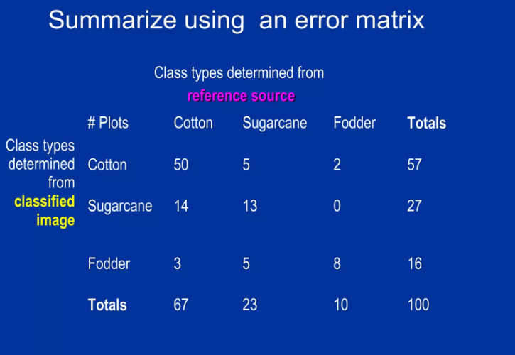
Error Matrix

Slide 8
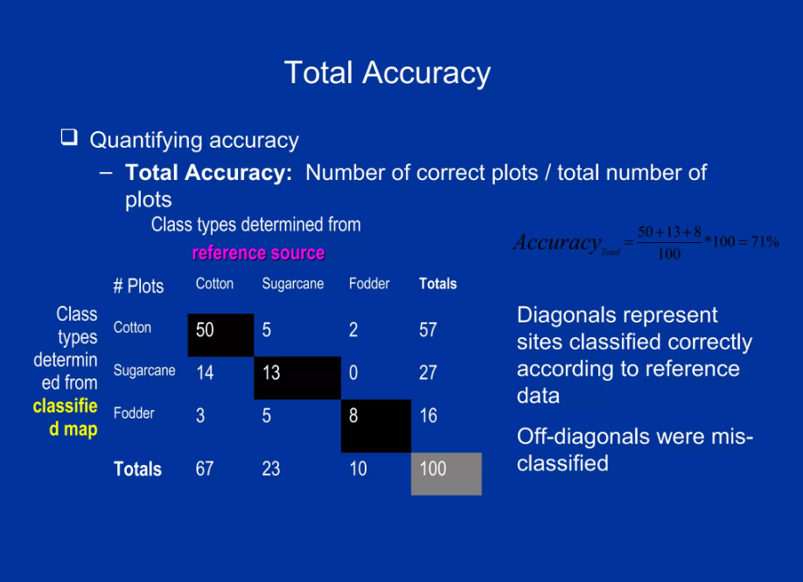

Slide 9
Total Accuracy
Also known as Overall accuracy
Challenge with total accuracy is an average it does not reveal if error was evenly distributed between classes or if some classes were really bad and some really good
To understand the accuracy of specific classes, the following accuracy metrics are used 1) User accuracy
2) Producer accuracy

Slide 10
User accuracy
User accuracy is defined as the error of commission (inclusion)
User accuracy is calculated by dividing the number of correctly classified samples for a specific class by the total number of samples classified as that class.
A low user accuracy value indicates a high commission error rate, indicating that the classification algorithm is prone to misclassifying samples as belonging to the specific land cover class when they actually do not.

Slide 11
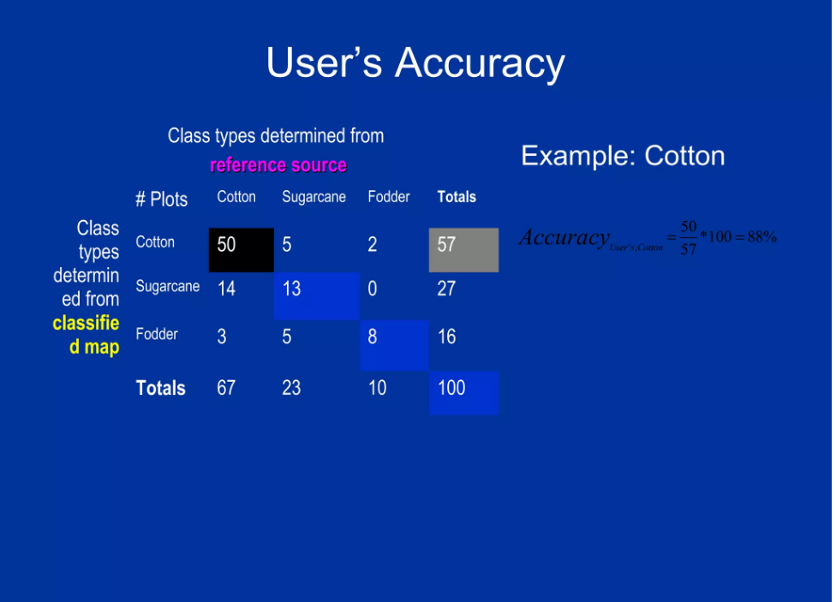

Slide 12
Producer Accuracy
Producer accuracy is defined as the error of omission (exclusion).
Producer accuracy quantifies the proportion of correctly classified samples within a specific land cover class.
Producer accuracy is calculated by dividing the number of correctly classified samples for a specific class by the total number of ground truth samples belonging to that class.
A low producer accuracy value indicates a high omission error rate, indicating that the classification algorithm frequently fails to classify samples as belonging to the specific land cover class when they actually do.

Slide 13
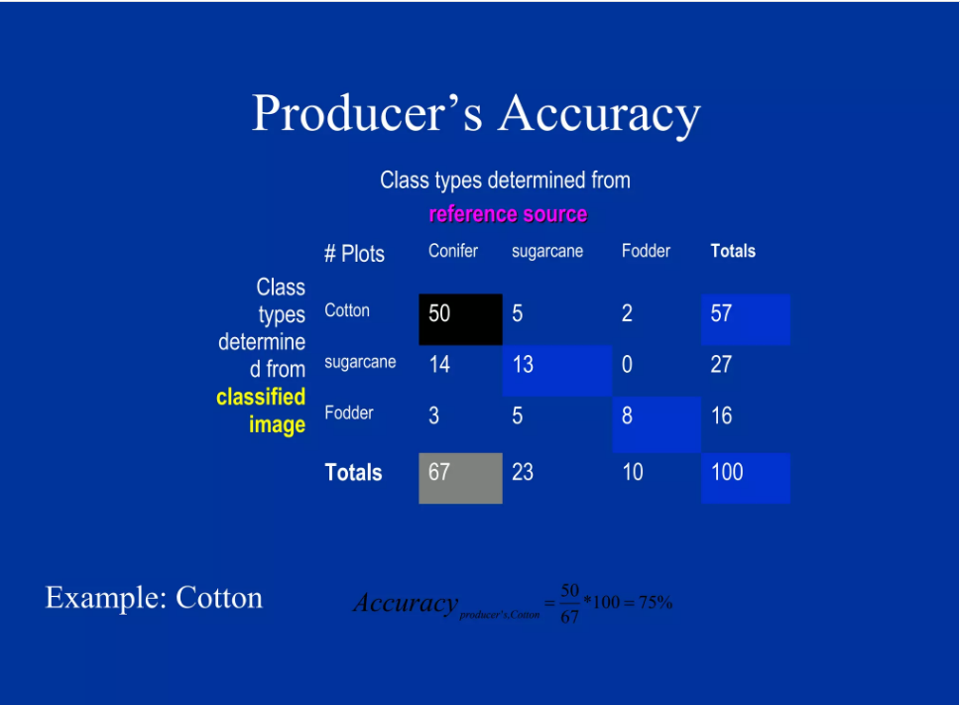

Slide 14
Exercise
Calculate the producer and user accuracy of sugarcane and fodder land cover classes.
What is more acceptable overestimation or underestimation?

Slide 15
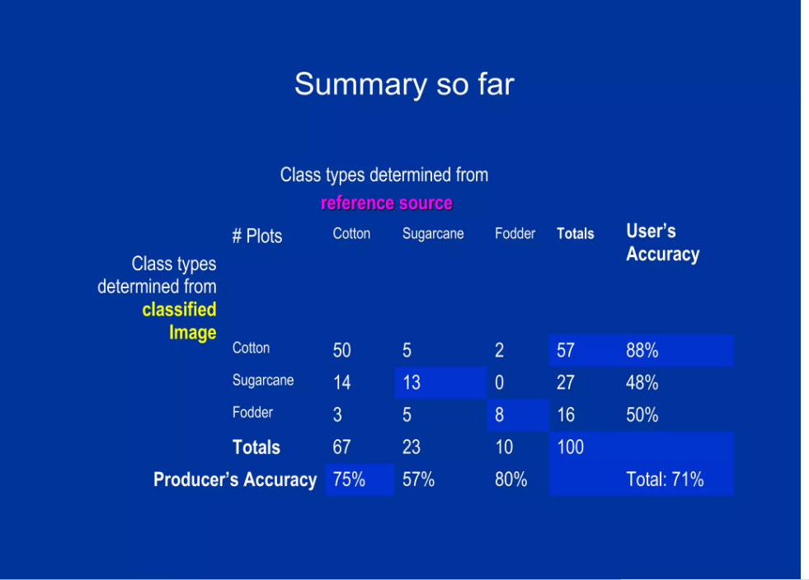


Slide 16
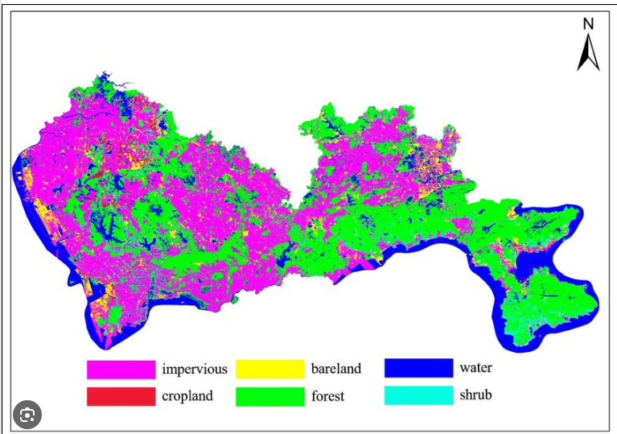

Slide 17
Factors affecting accuracy in image classification
Spectral confusion
Similar Reflectance Characteristics: Land cover classes with similar reflectance characteristics across the electromagnetic spectrum can result in spectral confusion.
Different vegetation types or soil compositions may have similar spectral responses, making it difficult to distinguish between them
Spectral confusion can contribute to both commission errors (incorrectly assigning a class label) and omission errors (failing to assign a class label).

Slide 18
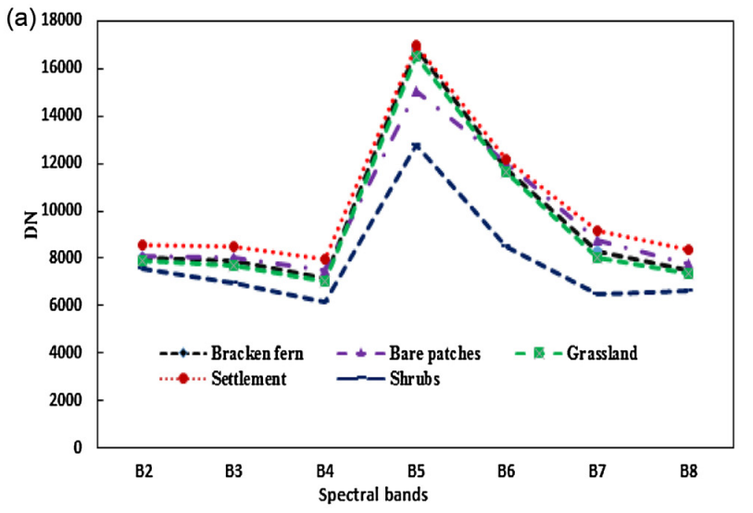

Slide 19
Factors affecting accuracy in image classification
2. Mixed pixels
Mixed pixels are areas on a remote sensing image where the ground truth land cover is not homogeneous or exhibits a spatial mixture of different land cover types.
Spectral confusion can also arise when a pixel contains a mixture of multiple land cover types, resulting in a blended spectral signature that does not clearly correspond to a single class.

Slide 20
Factors affecting accuracy in image classification
3. Sensor Characteristics
Different sensor characteristics influence the quality and characteristics of the acquired imagery, which in turn impact the classification process
Spatial resolution
Spectral resolution
Radiometric resolution

Slide 21
